Slide 1







Building the IA Operating System of LatAm enterprises, one workflow at a time

Slide 2
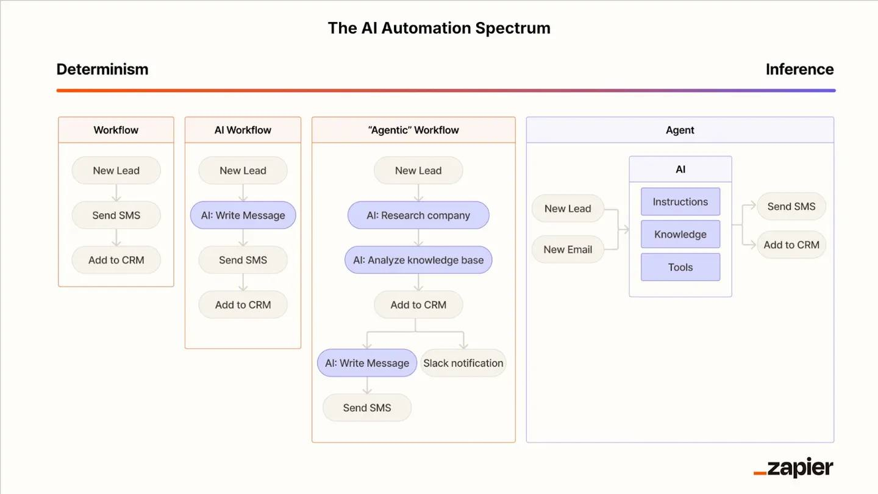
AI is transforming enterprises globally. LatAm is 3-5 years behind.
The gap isn't technology—it's translation.
Companies with $500M+ in revenue across LatAm still run on WhatsApp, Excel, and tribal knowledge as their Operating System.
The companies that bridge this gap first will own the market.

Slide 3
Large LatAm enterprises are drowning in informal processes and legacy systems
100+
+500
$1.5M
Systems x holding with 15-30% actual usage
Employees with knowledge, trapped in their heads, not systems
Buried in operational fatigue (excel + whatsapp)
They need someone who will dig in, understand THEIR reality, and deliver measurable outcomes.

Slide 4
The problem is not AI implementation,
is the 🐓 (training) or 🥚 (ai-solutions) problem
"Sobre el uso de Power BI, tengo algunas deficiencias:
> 1. **Está limitado únicamente a información de ventas, sin acceso a otros datos relevantes.**
> 2. Existen problemas frecuentes (dos veces por semana) en las bases de datos que alimentan el Power BI, afectando la integridad de la información.
> 3. Aún no se ha logrado una implementación integral del ERP a nivel empresarial, limitando su uso a un nivel meramente visual."
Luis Nogales - Financial Manager (Family Office Company)
"Es complejo evaluar actualmente, ¿me podrías podrías evaluar por el costo alimento?, si está bien controlado, pero estamos en una situación donde los insumos suben rápidamente entonces vamos a tener un costo de alimentos bien ajustado. es complicado ¿No? No sé cómo me evaluaría mi personal con qué métricas a mí, ¿no? Lo único que tenemos es ver cuánta gente llega al restaurante."
Diego Alcantara - Executive Chef 5-star hotel
"Dependencia de proveedores 'aprobados' Cuando un proveedor es único para un producto o servicio específico, cualquier inconveniente con él (falta de stock, incumplimientos) genera un cuello de botella. Riesgo de quiebre de stock o retrasos en proyectos críticos. Y estos pasan normalmente xq no alcanzo a responder mi mail o mi wapp"
Alejandra Florez - Supervisora de Comercio Exterior y logística

Slide 5
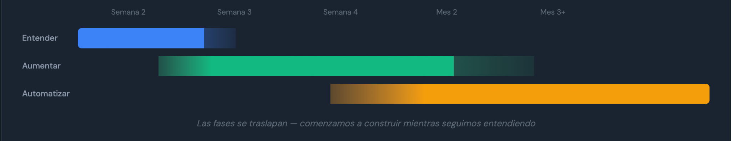
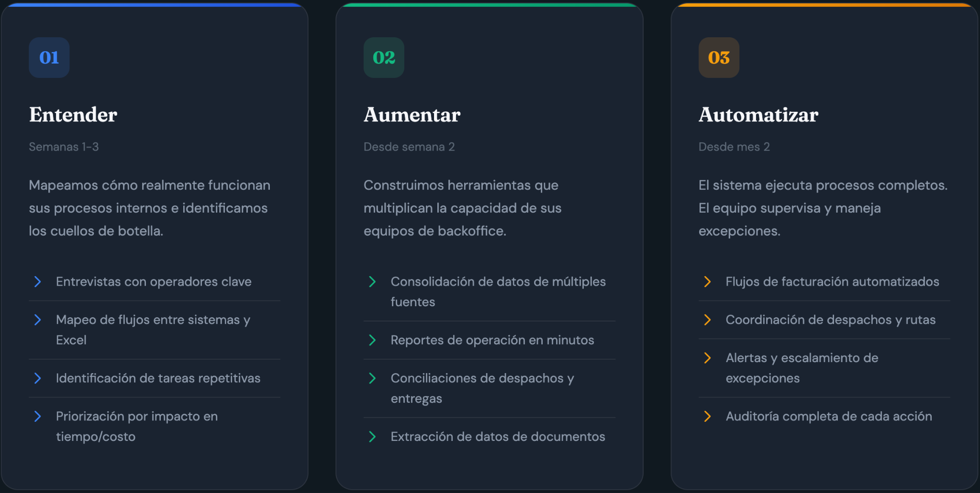
We have created AI implementations for complex organizations before

Slide 6
OUR SOLUTIONS
And we created a method (and agentic workflows) to scale it
Without excavation = we build the wrong stuff
Without building: we become another powerpoint

Slide 7

This is what enterprise clarity looks like

Slide 8
We love profitable businesses,
we are building one from scratch
134k
+68
$1.5M
Confirmed Revenue
Interviews processed in 2 weeks
Potential Value Identified
+2,700 internal proprietary company data linked, synced, organized and 292 opportunities waiting to be automated (+$100k in added revenue)

Slide 9
More Entities (data) = More Revenue
TBD

Slide 10
We ship products fast 💨,
Entity extractor and relational analyzer
Automation Platform
Custom made Service Desk
AI financial workflows
AI Marketing workflows
Whatsapp Interviews
Started Ops
Sep
Oct
Nov
Dec
Jan
…
2026

Slide 12
We only get paid for outcomes
These are the only 4 that matter:
Outcome | How we measure | Example
Reduce Headcount | FTEs eliminated or redeployed | 4 conciliation roles → 0 = $48K/year saved
Optimize Process | Hours saved per week/month | Contract generation: 4 hours → 15 minutes
Increase Revenue | $ directly attributed | Call center automation → 20% more bookings
Reduce Costos | CAC, COGS, or overhead reduction | Lead qualification → 30% lower CAC
If we can't tie our work to one of these four outcomes, we don't do the project

Slide 13
Why now.
AI Anxiety is peaking.
LatAm is Underserved
Solid global case studies
We’ve done the hard part
Every enterprise CEO fears being left behind. They’ll pay for clarity
Traditional consultants don't understand AI, nor internal teams. Local AI players lack business depth
Complex global franchises operators like Marriot, Burger King impose legacy systems
These are our 1st customers.
68 interviews, 1 proven client with upsell, working methodology. The same team diagnose and implement

Slide 14
Our Competition
Can Diagnose effectively
McKinsey
Accenture
Deloitte
Software
vendors
Traditional local consulting firms
Local n8n/zapier implementors
Can implement Effectively
Notes:
https://metodo-ai.netlify.app/

Slide 15
We will win if…
MOAT
GAP
SOLUTION
Proprietary Data MOAT
We have 68 interviews from one client. That's not a moat
Every engagement feeds a benchmark database. "Your process takes 4 hours; industry average is 45 minutes." Clients pay for the insight, not just the fix
Switching Costs
If we leave, client can hire someone else.
Director AI becomes the brain. Once it knows where everything is, replacing it is painful. Embed deeply, then maintain.
Network Effects
Each client is isolated.
Anonymized learnings across clients. "We've seen this problem at 12 companies; here's what works." Clients benefit from the collective.
Recurring Revenue
100% project-based today.
Director AI subscription + maintenance retainers. Target: 40% recurring by end of Year 1.

Slide 16
Business Model
 | Diagnosis | Implementation | Director AI
Price | $5-15K USD /company | $15-50K USD | $20/usuario/mes
Duration | 3-6 weeks | 2-4 months | Ongoing
Deliverable | Company Map + Automation Roadmap + $ savings/revenue identified | Automations working from week 2, fully automated systems | “Company GPT” with all the company knowledge base
Margin | 70%+ | 50-60% | 80%+
Natural Expansion: Every diagnostic generates 3-5 implementation projects

Slide 17
Go To Market
Phase 1: Your companies first (Months 1-6)
Konfíe, Huevos Kike, OPL Carga
Diagnostics + Initial Automations
Proof of concepts with your own funds
Phase 2:
Logistics Playbook (Months 6-12)
Patterns identified in 3+ companies
Replicable methodology
AI workflows build specifically for logistics ventures
Phase 3:
Regional Scale (Year 2)
Expand Bolivia + Colombia + Peru
Team of 8-10 people
$1M+ ARR

Slide 18





The team
Daniel Restrepo Founder & COO
Daniel Cardona Founder & CEO
TO BE HIRED API and technical expert
• Process Integrator
• Agentic Solutions Implementer
• 110 automated process in 9 areas
• Jiu jitsu Black Belt
• Creative & Storyteller
• Go to market Implementer
• AI Systems Thinker
• $150M+ Pipeline for B2B

Slide 19
Why us?
Organizational archeology
LatAm native in Complex Orgs
We Ship,
not Slide
We don't trust org charts. We interview everyone
—68 interviews > 292 opportunities identified in our first engagement.
We see what's actually happening, not what the CEO thinks is happening.
We understand that WhatsApp and Excel are the real operating systems.
We know that "mañana" means next week.
We've worked inside LatAm enterprises and know where the bodies are buried.
We don't deliver PowerPoints—we deliver working systems. We uncover and validate with teams
Our first client has automations running in production, not decks sitting in a folder.

Slide 20
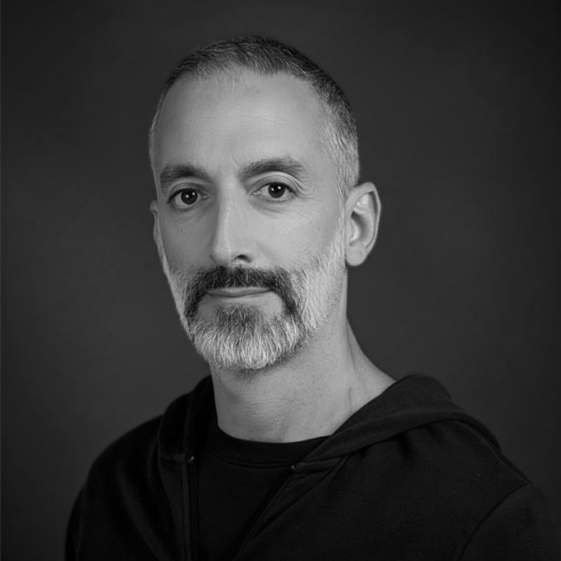

Advisors
Bambos Kaisharis Ex-googler
Tomas Shuk Serial Entrepreneur
• Commercial & Gtm Architect
• Hardware & Service Scaling
• Global Operations
• Serial Entrepreneur
• Logistics and International Comex
• Trade Finance

Slide 22
APPENDIX

Slide 23
P

